Slide 1

KIDS LEARNING GAME
presentation
Degree of
BACHELOR OF TECHNOLOGY
in
COMPUTER SCIENCE AND ENGINEERING
By
Registration No. | Name | Roll No.
12115358 | MD ISHTIYAQUE | RK21QTA27
12115058 | Sahil ding | RK21QTA02
12115110 | Ma lucky ahmad | RK21QTB51
Under the guidance
NAVPREET RUPL
School of Computer Science and Engineering
Lovely Professional University Phagwara, Punjab (India) NOV 2022

Slide 2
TABLE OF CONTENTS
CONTENTS PAGE NO.
1. INTRODUCTION……………………………………………………7
1.1. Introduction……………………………………………………………..7
1.2. Uses……………………………………………………………………..7
1.3. Special Button………..…………………………………………………7
2. METHODOLOGY…………………………………………………..11
2.1. Requirements……………………………………………………………11
2.2. Functionality…………………………………………………………….11
2.3. Implementation…………………………………………………………..13
2.4. Debugging………………………………………………………………..13
2.5. Execution…………………………………………………………………13
2.6. Working…………………………………………………………………..13
3. TECHNOLOGY……………………………………………………….18
3.1. Python 3.7…………………………………………………………………18
3.2. GUI………………………………………………………………………...18
3.3. IDE…………………………………………………………………………18
3.4. Tkinter……………………………………………………………………...18
3.5. Widgets classes………...…………………………………………………..18 3.6. Option with values………………………………………………………….18

Slide 3
LIST OF FIGURES
Fig No. | Name | Page No.
1.3.1 | Start now button | 7
1.3.2 | Image button | 8
1.3.3 | Parrot button | 8
1.3.4 | Exit button | 9
1.3.5 | Submit button | 9
1.3.6 | Home button | 10
1.3.7 | Ok button | 10
1.3.8 | Message box | 10
2.6.1 | About us home page | 14
2.6.2 | KLG home page | 14
2.6.3 | 12 Images | 15
2.6.4 | Checkbox | 15
2.6.5 | Checkbox with messagebox | 16
2.6.6 | Checkbox with thank you image | 16
2.6.7 | Flow chart | 17

Slide 4

CHAPTER 1 INTRODUCTION
Introduction
Based on Image Recognition, a game is designed in which the kids will sees the various images for some particular time duration and after that they have to recognize them by the names of images.
Uses
By developing this game, we will predict the number of images` that are correctly recognized by a user from total number of images.
All the button used in this project perform some special kind of operations.
Start the game
Continue the playing
Exit from the program
Returning the total number of images that are correctly recognize
Printing the total number of images that are correctly recognize
Button used in this project are like EXIT, START, OK, SUBMIT etc.
1.3. Special Button
Kids Learning Game uses some buttons. All the button used in this program are
START NOW
EXIT
OK
SUBMIT
HOME
IMAGE BUTTON
START NOW
Fig 1.3.1
Code we used in our program…

Slide 5
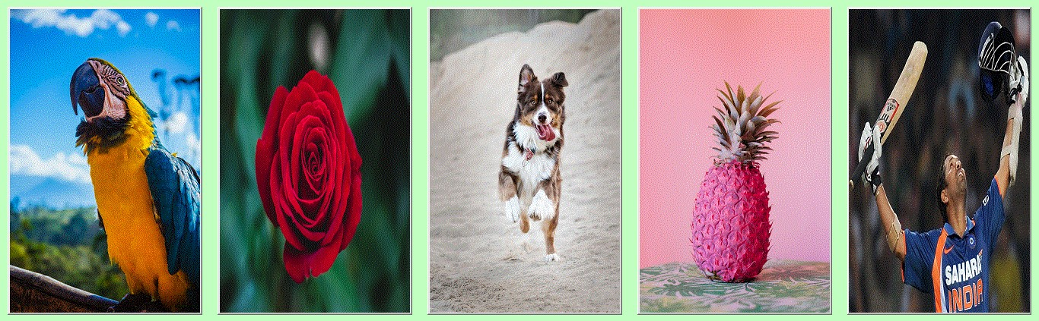
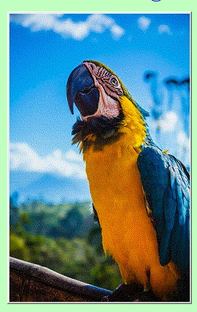
Button(about_us_window3, image=start, command=home_page).pack(anchor=NW, padx=200,
pady=30)
This button is defined in the in the program named “about_us.py”. This button starts our program.
On clicking on this button, we will go to the program name “klg.py” from “about_us.py”.
IMAGE BUTTON
Fig 1.3.2
Code we used in our program…
Button(frame1, image=homebird, command=birds).pack(side=LEFT, padx=10)
Button(frame1, image=homeflower, command=flowers).pack(side=LEFT, padx=10) Button(frame1, image=homeanimal, command=animals).pack(side=LEFT, padx=10) Button(frame1, image=homefruit, command=fruits).pack(side=LEFT, padx=10) Button(frame1, image=homeplayer, command=players).pack(side=LEFT, padx=10)
Fig 1.3.3
Code we used in our program…
Button(frame1, image=homebird, command=birds).pack(side=LEFT, padx=10)
This button is defined in the in the program named “about_us.py”. There are five button we used here. This button are the images.

Slide 6



On clicking any of the image we will see 12 images. The images we can see according to the image we click
For example, if we click on flower, we can see 12 different flowers.
EXIT
Fig 1.3.4
Code we used in our program…
Button(frame3, text="EXIT", bg="darksalmon", fg="yellow", bd=3, cursor="arrow",
command=exit).pack(side=LEFT, padx=10, pady=25, ipadx=30)
This button is defined in the in the program named “klg.py”.
On clicking on this button, we will exit from the program and no further execution is done.
OK
Fig 1.3.5
There are two OK buttons is used in this project. Code we used in our program…
Button(frame1, text="OK", bg="darksalmon", fg="yellow", bd=3, cursor="arrow",
command=okProcess).grid(row=3, column=4, sticky=W, padx=10, pady=10, ipadx=30)
This button is defined in the in the program named “klg.py”.
On clicking on this button means continue the game. We will see list of 20 images name. We can select the name and go to SUBMIT button.
SUBMIT
Fig 1.3.6
Code we used in our program…
Button(frame2, text="SUBMIT", bg="darksalmon", fg="yellow", bd=3, cursor="arrow",
command=printing).grid(row=5, column=1, padx=10, pady=10, ipadx=20)
This button is defined in the in the program named “klg.py”.
On clicking this button, a messagebox will appear where we can see the total number of images correctly recognize.

Slide 7


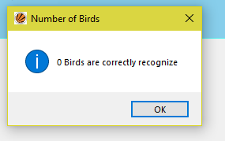
HOME
Fig 1.3.7
Code we used in our program…
Button(frame2, text="HOME", bg="darksalmon", fg="yellow", bd=3, cursor="arrow",
command=home).grid(row=1, column=6, padx=200, pady=10, ipadx=20)
This button is defined in the in the program named “klg.py”.
On clicking on this button, we will go to the program name “about_us.py” from “klg.py”.
OK
Fig 1.3.8
No code is there to use this button. This button is present on message box.
Fig 1.3.9
On clicking this button, we will get percentage of accuracy.

Slide 8
CHAPTER 2 METHODOLOGY
Requirements
First step is gathering our requirements of the project. The functions and the modules and the necessary for the development of the project.
Functionality
In this step we will discuss the different function used in the program and how they are working.
The different types of function we used are…
home_page()
birds()
flowers()
animals()
fruits()
players()
okProcess()
counting()
printing()
home()
Now we will discuss working of each of the function.
home_page()
This function is defined in the program named “about_us.py”. Code we used is…
def home_page():
about_us_window.destroy() import os os.system("python klg.py")
Working of this function is to destroy the current window and move to new program named “klg.py”.
birds()
This function is defined in the program named “klg.py”.
Working of this function is to destroy the current window and display a new window with 12 images and some text and some button.
flowers()
This function is defined in the program named “klg.py”.

Slide 9
Working of this function is to destroy the current window and display a new window with 12 images and some text and some button.
animals()
This function is defined in the program named “klg.py”.
Working of this function is to destroy the current window and display a new window with 12 images and some text and some button.
friuts()
This function is defined in the program named “klg.py”.
Working of this function is to destroy the current window and display a new window with 12 images and some text and some button.
players()
This function is defined in the program named “klg.py”.
Working of this function is to destroy the current window and display a new window with 12 images and some text and some button.
okProcess()
This function is defined in the program named “klg.py”.
This function destroys the current frame. After that a list of 20 images name will appear including the image that are previously shown.
counting()
This function is defined in the program named “klg.py”. Code we use is…
def counting():
count = v1.get() + v2.get() + v3.get() + v4.get() + v5.get() + v6.get() + v7.get() + v8.get() + v9.get() + v10.get() + v11.get() + v12.get()
return count
This function returns the number of images that are correctly selected.
printing()
This function is defined in the program named “klg.py”. Code we used is…
def printing():
messagebox.showinfo("Number of Birds", str(counting()) + " Birds are correctly recognize")
L = Label(frame2, bg="skyblue", fg="black", font="gabriola 30 italic underline")
L.grid(row=5, column=2, columnspan=15)
L.config(text="Percentage of Accuracy is " + str("%.2f" % ((counting() * 100) / 12)) + "%")
Label(frame3, image=smile).grid(row=1, column=1, padx=100, pady=50)
Label(frame3, text="Thank You !!!", bg="#46f0f0", fg="blue", font="chaurcer 25 italic").grid(row=1, column=2, sticky=N, pady=180)

Slide 10
Label(frame3, text="Press EXIT to end Playing...", bg="#46f0f0", fg="blue",
font="garamond 30 italic").grid(row=2, column=1, sticky=W, padx=10, pady=10) Button(frame3, text="EXIT", bg="darksalmon", fg="yellow", bd=3, cursor="arrow",
command=exit).grid(row=2, column=2, sticky=W, padx=10, pady=10, ipadx=30)
This function shows a messagebox with total number of images that are correctly recognize. And it will also print the percentage of accuracy.
home()
This function is defined in the program named “klg.py”. Code we used is…
def home():
window1.destroy() import os
os.system("python about_us.py")
This function destroys the current window and move to the new program named “about_us.py”.
Implementation
This step is to implementing the project by coding. This is most important part of the program. A particular care should be done in order to get error free program.
Debugging
This step is to check the project for any errors in the code. And linking of the module take place after checking individual modules and functions.
Execution
This step is to executing the project and simple testing.
Working
We have used tkinter library to develop GUI for the project. We import sys library to know the current version we are using.
We import messagebox from tkinter to show information. We import os for linking a program with another program.
The detail description about the working of the project is discussing now. On running the program name “about_us.py” we will see the interface like this

Slide 11
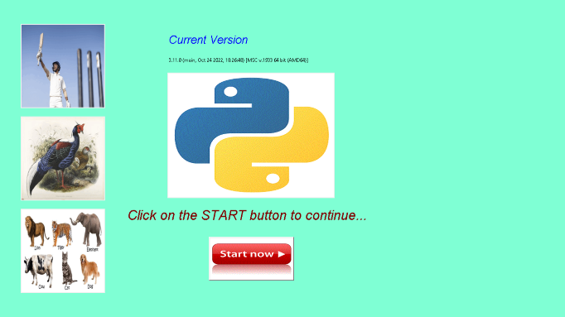
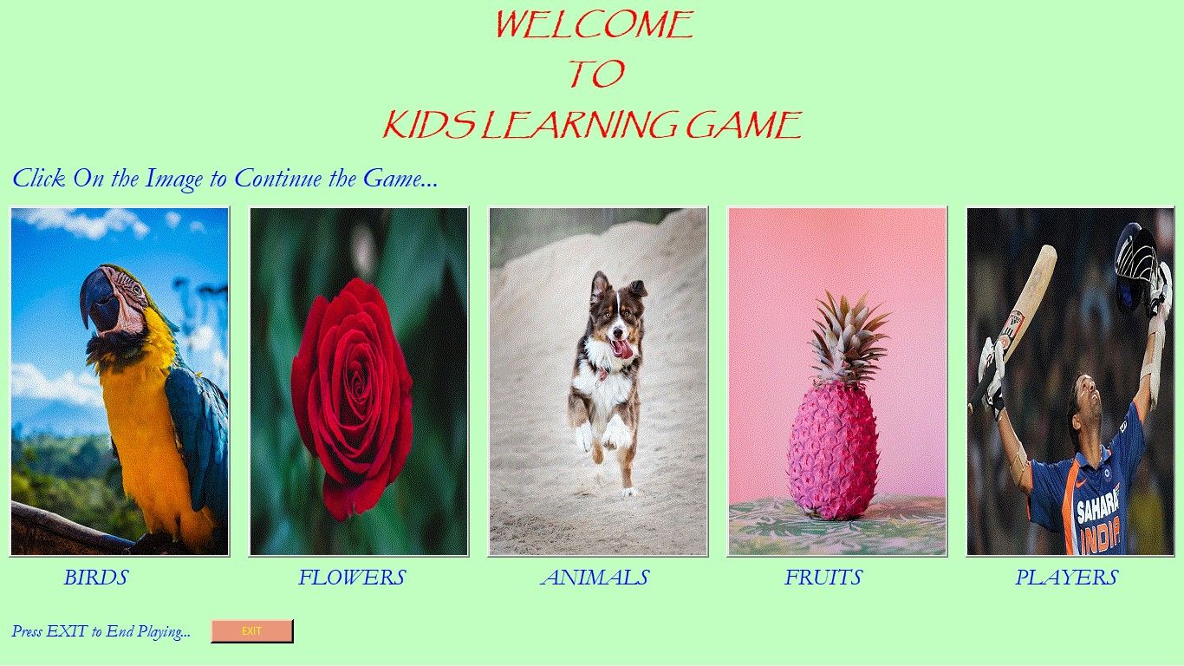
Fig 2.6.1
On clicking the start button, current window is destroyed and move to the program named “klg.py”. The interface will look like this
Fig 2.6.2
These five images are the button. On clicking any of the one we will move to the next window.
If we click on EXIT button, we will exit from the program and no further processing is done.
We will discuss the things that happen on click BIRDS image i.e. Parrot. On clicking it we will destroy the current window and next interface will look like this

Slide 12
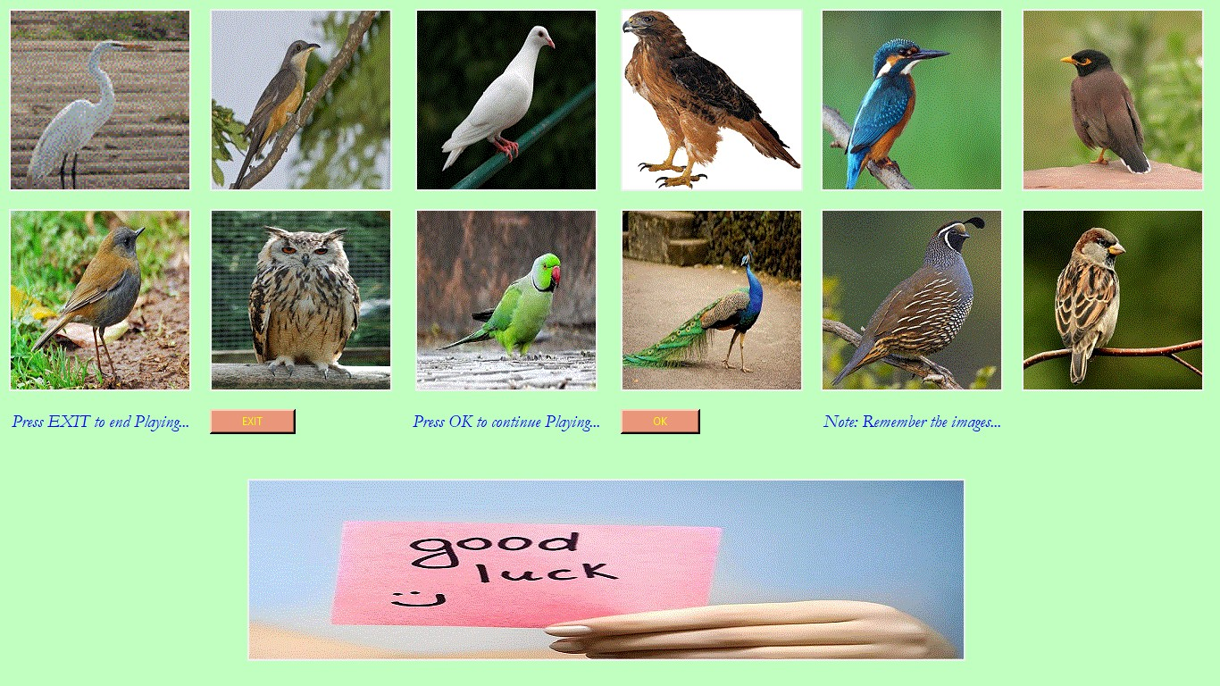
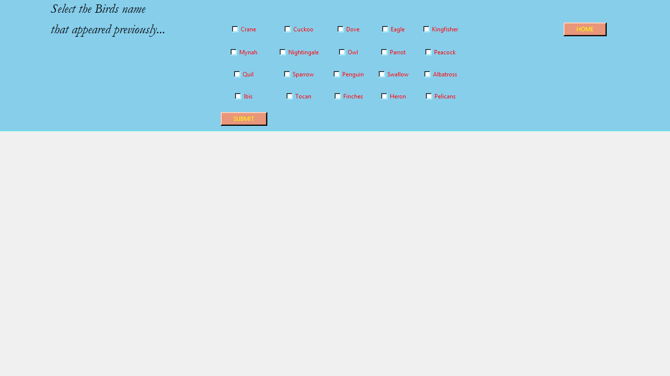
Fig 2.6.3
If we click on EXIT button, we will exit from the program and no further processing is done.
On click OK button current frame is destroy and we get a new interface like this
Fig 2.6.4
After selecting the images name, click on the SUBMIT button. The interface will look like

Slide 13
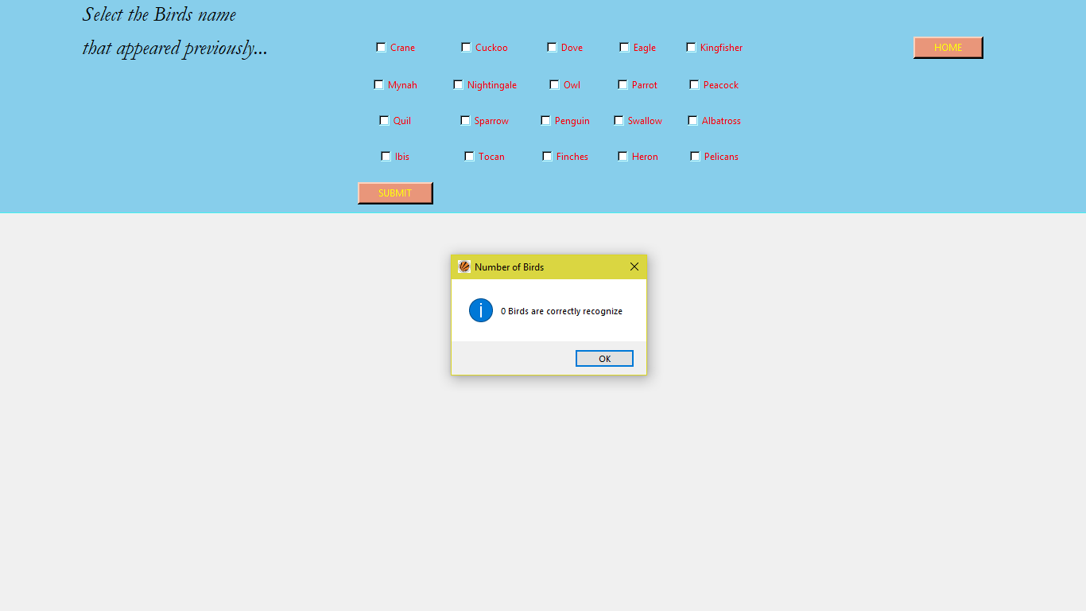
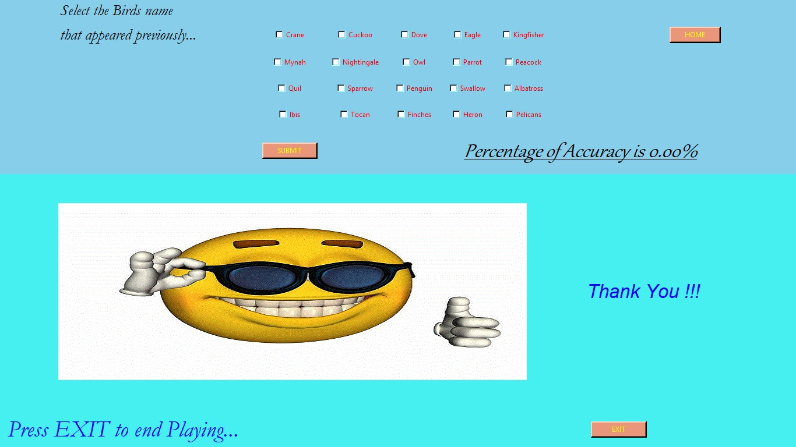
Fig 2.6.5
On clicking OK button, we will get the accuracy of the image i.e. number of images that are correctly recognize and the interface will look like this
Fig 2.6.6
If we click on EXIT button, we will exit from the program and no further processing is done.
If we click on the HOME button, current window will destroy and we move to the program name “about_us.py”. The same thing will happen again.

Slide 14
CHAPTER 3 TECHNOLOGY
Python 3.7
Python is an interpreted, object-oriented, high-level programming language with dynamic semantics. Its high-level built in data structures, combined with dynamic typing and dynamic binding, make it very attractive for Rapid Application Development, as well as for use as a scripting or glue language to connect existing components together.
Python's simple, easy to learn syntax emphasizes readability and therefore reduces the cost of program maintenance. Python supports modules and packages, which encourages program modularity and code reuse.
GUI
Short for Graphical User Interface, a GUI (pronounced as either G-U-I or gooey) allows the use of icons or other visual indicators to interact with electronic devices, rather than using only text via the command line.
A GUI uses icons, and menus to carry out commands, such as opening, deleting, and moving files.
IDE
Integrated development environment (IDE) used is PyCharm. It provides code analysis, a graphical debugger, an integrated unit tester etc.
Tkinter
Python offers multiple options for developing GUI. Out of all the GUI methods, tkinter is most commonly used method. It is a standard Python interface to the Tk GUI toolkit shipped with Python. Python with tkinter outputs the fastest and easiest way to create the GUI applications.
Widgets classes
Tkinter’s GUI classes define common GUI widgets such as button, labels, check buttons, frames, canvases and other. We will use some of them in our project.
Option with values
Widgets classes contains option with their values to change the interface of the widgets classes means appearance of the window. Some of the option are width, height, fg, bg, side, row, column, text, onvalue, offvalue, variable, expand, fill, file, image, command and so on.

